Slide 1


Borcelle University
MACHINE LEARNING AND SIMULATION-BASED FRAMEWORK FOR DISASTER PREPAREDNESS PREDICTION
Presented By :
SHOWRIN RAHMAN
ID:21301033
Presented For:
Z. Jiang, R. Ji, Y. Chen and W. Ji, "Machine Learning and Simulation-Based Framework for Disaster Preparedness Prediction," 2021 Winter Simulation Conference (WSC), Phoenix, AZ, USA, 2021, pp. 1-10, doi: 10.1109/WSC52266.2021.9715322.
URL: https://ieeexplore.ieee.org/stamp/stamp.jsp?tp=&arnumber=9715322&isnumber=9715284
CSE 474
SIMULATION AND MODELING

Slide 2

Introduction
Introduction to the significance of disaster preparedness in community resilience.
Importance of understanding residents' preparedness levels for efficient and equitable relief operations.
Overview of the research objective: Developing a machine learning and simulation-based approach for disaster preparedness prediction.
Research Methodology
Explanation of the four-step approach:
Data Collection and Integration: Utilizing FEMA National Household Survey data, US census data, and county-level disaster declaration data.
Model Training: Training multiple classification models and selecting the best-performing one.
Simulation: Simulating resident demographic features at the county level.
Prediction: Predicting disaster preparedness status using simulated data for a selected county.

Slide 3

DATA SOURCES
DETAILS ABOUT THE DATA SOURCES USED, EMPHASIZING THE IMPORTANCE OF MULTISOURCE DATA FOR COMPREHENSIVE ANALYSIS.
FEMA NATIONAL HOUSEHOLD SURVEY DATA
US CENSUS DATA
COUNTY-LEVEL DISASTER DECLARATION DATA
MODEL TRAINING
OVERVIEW OF THE MACHINE LEARNING MODELS USED FOR CLASSIFICATION.
HIGHLIGHTING THE SIGNIFICANCE OF MODEL SELECTION BASED ON PREDICTION PERFORMANCE.
MENTION OF TECHNIQUES EMPLOYED FOR DATA PREPROCESSING AND FEATURE SELECTION.
SIMULATION PROCESS
EXPLANATION OF THE SIMULATION PROCESS AT THE COUNTY LEVEL.
DEMONSTRATING HOW DEMOGRAPHIC FEATURES ARE SIMULATED TO CREATE A REALISTIC REPRESENTATION OF THE COMMUNITY.

Slide 4

Disaster Preparedness Prediction
Details about predicting disaster preparedness status using simulated data.
Emphasizing the application of machine learning models to simulated demographic features.
Discussing the reliability and accuracy of the predictions achieved through the proposed framework.
Case Study
Presentation of a real-world case study highlighting the practical application of the proposed approach.
Discussing the specific county selected for the case study.
Sharing insights and outcomes obtained from the case study to demonstrate the reliability and applicability of the framework.

Slide 5

NATURAL DISASTERS IMPACT:
HURRICANES, STORMS, AND EARTHQUAKES CAUSE SUBSTANTIAL ECONOMIC LOSSES AND HUMAN SUFFERING, DISRUPTING SOCIETAL FUNCTIONS AND CRITICAL INFRASTRUCTURE.
HURRICANE FLORENCE (2018): CAUSED $17.9 BILLION IN ECONOMIC DAMAGE AND 55 CASUALTIES, HIGHLIGHTING THE NEED FOR EFFICIENT DISASTER RESPONSE AND RECOVERY EFFORTS.
DEFINITION OF DISASTER PREPAREDNESS:
MEASURES TO PREDICT, PREVENT, MITIGATE, AND COPE WITH DISASTERS' CONSEQUENCES; CRUCIAL FOR REDUCING VULNERABILITY AND ENHANCING RESILIENCE AT INDIVIDUAL, HOUSEHOLD, AND COMMUNITY LEVELS.
Problem Statement

Slide 6

PROPOSED APPROACH
INTEGRATION OF MULTI-SOURCE DATA:
COMPILATION OF DEMOGRAPHIC INFORMATION FROM FEMA NATIONAL HOUSEHOLD SURVEY, US CENSUS, AND COUNTY-LEVEL DISASTER DECLARATION DATA.
MACHINE LEARNING MODELS:
UTILIZATION OF LOGISTIC REGRESSION, SUPPORT VECTOR MACHINE (SVM), RANDOM FOREST, AND XGBOOST TO ANALYZE THE RELATIONSHIP BETWEEN DEMOGRAPHIC FACTORS AND DISASTER PREPAREDNESS.
SIMULATION OF DEMOGRAPHIC FACTORS:
USE OF US CENSUS DATA AND GOVERNMENTAL DISASTER DECLARATION DATA FOR SIMULATING AFFECTED RESIDENTS' DEMOGRAPHIC FEATURES.
OUT-OF-SAMPLE MODEL EVALUATION:
ASSESSMENT OF PREDICTION MODEL PERFORMANCE USING SIMULATED DATA TO ENSURE RELIABILITY AND ACCURACY.
RESEARCH CONTRIBUTIONS
ENHANCED PREDICTION ACCURACY: INTEGRATION OF MULTI-SOURCE DATA IMPROVES THE EFFECTIVENESS OF DISASTER PREPAREDNESS PREDICTION MODELS.
FEASIBILITY AND APPLICABILITY: CASE STUDY DEMONSTRATES THE PRACTICALITY OF THE PROPOSED APPROACH IN REAL-WORLD SCENARIOS.
EFFICIENT RESOURCE ALLOCATION: ENABLES AGENCIES TO ALLOCATE RESOURCES EFFECTIVELY BY UNDERSTANDING VULNERABLE COMMUNITIES' PREPAREDNESS LEVELS.

Slide 7
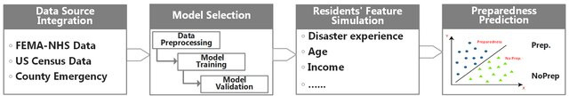
Methodology
FRAMEWORK OVERVIEW: OVERVIEW OF THE FOUR MODULES: DATA SOURCE INTEGRATION, MODEL SELECTION, RESIDENT FEATURE SIMULATION, AND PREPAREDNESS PREDICTION.
DATA SOURCES:
FEMA NATIONAL HOUSEHOLD SURVEY (NHS) DATA
US CENSUS DATA
COUNTY-LEVEL DISASTER DECLARATION DATA
MODULE 1: DATA SOURCE INTEGRATION:
MULTIPLE DATASETS ARE COLLECTED AND INTEGRATED, FORMING THE FOUNDATION FOR ANALYSIS.
MODULE 2: MODEL SELECTION:
SELECTION OF MACHINE LEARNING MODELS THROUGH A TRAINING-VALIDATION PROCEDURE FOR OPTIMAL PERFORMANCE.
MODULE 3: RESIDENT FEATURE SIMULATION:
SIMULATION OF THE AFFECTED COUNTY'S RESIDENT DEMOGRAPHIC FEATURES USING US CENSUS DATA.
MODULE 4: PREPAREDNESS PREDICTION:
APPLICATION OF THE SELECTED CLASSIFICATION MODEL TO PREDICT RESIDENT PREPAREDNESS IN THE TARGET COUNTY.
VISUALIZATION: DISPLAY OF FIGURE 1 SHOWCASING THE FRAMEWORK'S STRUCTURE AND FLOW.

Slide 8
DATA SOURCE INTEGRATION
FEMA NATIONAL HOUSEHOLD SURVEY (NHS) DATA:
UTILIZED 2017 AND 2018 NHS DATA FOR MODEL TRAINING AND VALIDATION.
SURVEYED ATTITUDES, EXPERIENCES, AND DEMOGRAPHICS RELATED TO HAZARD PREPAREDNESS.
CATEGORIZED RESPONSES INTO STAGES: PRE-CONTEMPLATION, CONTEMPLATION, PREPARATION, ACTION, AND MAINTENANCE.
DISASTER DECLARATION DATA:
COLLECTED FROM FEMA'S DISASTER DECLARATIONS PAGE.
INFORMATION ON REGIONS WHERE FEMA ASSISTANCE (PUBLIC OR INDIVIDUAL) IS PROVIDED POST-EMERGENCY DECLARATION.
ILLUSTRATIVE EXAMPLE FROM HURRICANE IRMA'S IMPACT ON FLORIDA COUNTIES.
US CENSUS DATA (2018 AMERICAN COMMUNITY SURVEY):
PROVIDED COUNTY-WISE DATA ON INCOME, AGE, AND EDUCATION LEVEL.
ESSENTIAL DEMOGRAPHIC INFORMATION ENRICHING THE SURVEY DATA.
SOURCED FROM THE U.S. CENSUS BUREAU'S AMERICAN COMMUNITY SURVEY.
INTEGRATION STRATEGY:
TRAINING SET (2017 NHS DATA): FOUNDATION FOR MACHINE LEARNING MODEL DEVELOPMENT.
VALIDATION SET (2018 NHS DATA): USED TO FINE-TUNE AND SELECT MODELS.
SIMULATED DATA: ENRICHED NHS SURVEY DATA BY MIMICKING LOCAL RESIDENT DEMOGRAPHIC FEATURES AND DISASTER EXPERIENCE USING US CENSUS AND DISASTER DECLARATION DATA.

Slide 9
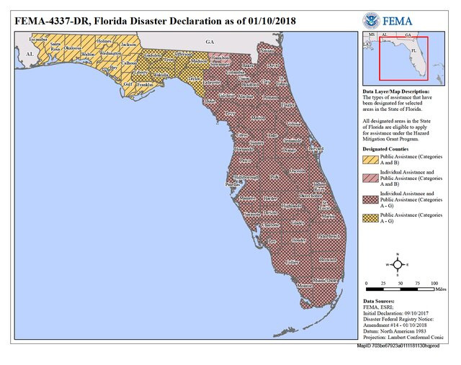
CLASSIFICATION MODEL SELECTION
IMPORTANCE OF DEMOGRAPHIC INFORMATION:
PRIOR STUDIES (KIM AND ZAKOUR 2017; DONNER AND LAVARIEGA-MONTFORTI 2018) EMPHASIZE THE SIGNIFICANT ASSOCIATION BETWEEN DEMOGRAPHIC FACTORS (E.G., INCOME, DISASTER EXPERIENCE) AND DISASTER PREPAREDNESS.
DATA FEATURES FOR CLASSIFICATION:
UTILIZING NHS DATA WITH PREDICTORS:
DISASTER EXPERIENCE.
DEMOGRAPHIC FACTORS: AGE, INCOME, EDUCATION LEVEL, GENDER, ETHNICITY.
MACHINE LEARNING MODELS:
LOGISTIC REGRESSION: LINEAR MODEL FOR BINARY CLASSIFICATION.
SUPPORT VECTOR MACHINE (SVM): EFFECTIVE FOR COMPLEX DATA PATTERNS.
RANDOM FOREST: ENSEMBLE METHOD FOR ROBUST PREDICTIONS.
XGBOOST: GRADIENT BOOSTING ALGORITHM FOR ENHANCED ACCURACY.
MODEL SELECTION PROCESS:
TRAINING-VALIDATION PROCEDURE:
ITERATIVE PROCESS TO EVALUATE MODELS' PERFORMANCE.
ELECTION BASED ON THE BEST PREDICTIVE ACCURACY
FIGURE 2: FLORIDA DISASTER DECLARATION:
VISUAL REPRESENTATION OF DISASTER DECLARATION ILLUSTRATING AFFECTED AREAS.

Slide 10
Resident Feature Simulation
CHALLENGES IN SURVEY DATA: SURVEY DATA FROM FEMA NHS MIGHT LACK COMPREHENSIVE DEMOGRAPHIC INFORMATION FOR SPECIFIC REGIONS AFFECTED BY DISASTERS.
MONTE CARLO APPROACH:
SIMULATION METHOD: UTILIZING MONTE CARLO APPROACH TO MIMIC RESIDENT DEMOGRAPHIC FEATURES.
OBJECTIVE: TO FILL GAPS IN DEMOGRAPHIC INFORMATION, ENHANCING THE DATASET'S COMPLETENESS.
SIMULATION PROCEDURE:
DATA COLLECTION:GATHER DISTRIBUTIONAL INFORMATION FROM THE TARGET COUNTY VIA USCB WEBSITE.
SIMULATION PROCESS:SIMULATE INDIVIDUAL DEMOGRAPHIC FEATURES INDEPENDENTLY USING US CENSUS DATA.
GENERATE SAMPLES FOR MISSING FEATURES BASED ON CENSUS DISTRIBUTIONS.
COMBINE INDIVIDUAL FEATURES TO CREATE RESIDENT DEMOGRAPHIC PROFILES.
RESULTANT DATASET:
CONSTRUCTION OF A DATASET FOR THE TARGET COUNTY WITH SIMULATED DEMOGRAPHIC INFORMATION.
BENEFITS OF SIMULATION:
DATA ENRICHMENT: AUGMENTED DATASET IMPROVES PREDICTION ACCURACY.
PREDICTIVE ANALYSIS: ENHANCED DEMOGRAPHIC PROFILES ENABLE MORE PRECISE DISASTER PREPAREDNESS PREDICTIONS.

Slide 11

Data Limitations:
Availability: NHS dataset limited to 2017 and 2018.
Imbalance: Imbalanced data across counties and states due to survey limitations.
Coverage: Limited coverage, especially in smaller counties, as shown
DATA PREPARATION AND EXPLORATORY ANALYSIS
DATA FILTERING AND CLEANING:
FILTERED DATA: 1263 OBSERVATIONS FOR 2017 NHS, 1240 FOR 2018 NHS.
DATA CLEANING: REMOVED MISSING VALUES; 1001 SAMPLES (2017) AND 724 SAMPLES (2018) REMAINED FOR MODEL CONSTRUCTION.
FOCUS STATES:
STATES INCLUDED: ALABAMA, FLORIDA, GEORGIA, LOUISIANA, SOUTH CAROLINA, TEXAS.
RATIONALE: THESE STATES AFFECTED BY HURRICANES (2016-2018) CHOSEN FOR FOCUSED ANALYSIS.

Slide 12
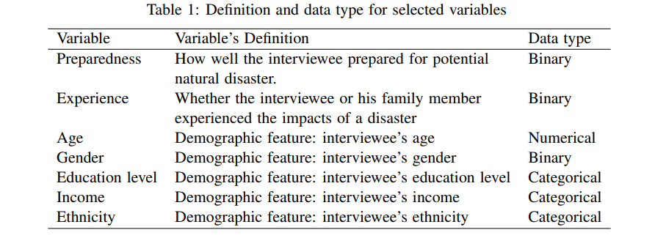
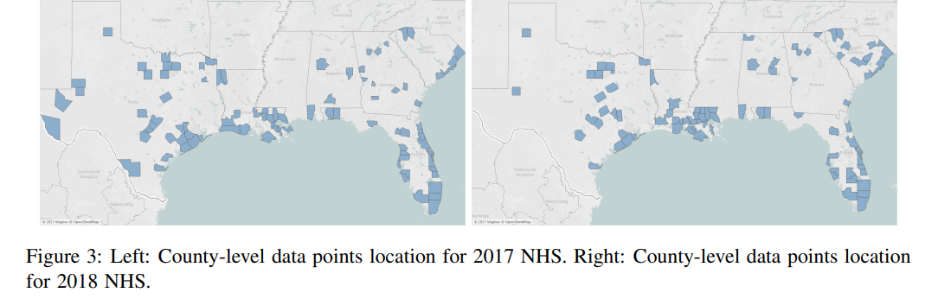
VARIABLE DESCRIPTION:DETAILED OVERVIEW OF VARIABLES USED IN THE ANALYSIS

Slide 13

FEATURE SELECTION:
LITERATURE BASIS: INITIAL VARIABLES FROM EXISTING RESEARCH (KIM AND ZAKOUR 2017; DONNER AND LAVARIEGA-MONTFORTI 2018) HIGHLIGHTING DEMOGRAPHIC FEATURES AND DISASTER EXPERIENCE.
BEST SUBSET SELECTION METHOD: UTILIZED TO OPTIMIZE FEATURE SET FOR EACH MODEL.
OPTIMAL FEATURES: AGE, INCOME, AND DISASTER EXPERIENCE IDENTIFIED AS SIGNIFICANT PREDICTORS ACROSS ALL MODELS.
MODEL PARAMETER FINE-TUNING:
LOGISTIC REGRESSION:
LINK: LOGIT
COST: 1
SUPPORT VECTOR MACHINE (SVM):
KERNEL: LINEAR
COST: 1
RANDOM FOREST:
NUMBER OF TREES (NTREE): 2500
NUMBER OF VARIABLES (MTRY): 3
XGBOOST:
MAXIMUM DEPTH: 2
MINIMUM CHILD WEIGHT: 1
ETA: 0.3
OBJECTIVE: BINARY:LOGISTIC
EVALUATION METRIC:
PREDICTION ACCURACY: USED TO ASSESS MODEL PERFORMANCE DURING PARAMETER FINE-TUNING.
RESULT VALIDATION:
PARAMETERS SELECTED THROUGH RIGOROUS COMPARISON WITH TESTING DATA TO ENSURE ROBUSTNESS.
Feature Selection
and Model Training

Slide 14
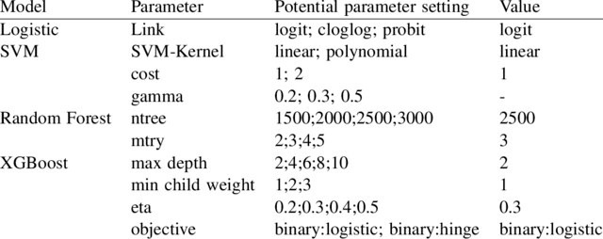
EVALUATION METRIC:
PREDICTION ACCURACY: USED TO ASSESS MODEL PERFORMANCE DURING PARAMETER FINE-TUNING.
RESULT VALIDATION:
PARAMETERS SELECTED THROUGH RIGOROUS COMPARISON WITH TESTING DATA TO ENSURE ROBUSTNESS.
POTENTIAL PARAMETER SETTING AND FINE-TUNING RESULTS.
FINE-TUNED PARAMETER SETTINGS:
PROVIDES AN OVERVIEW OF POTENTIAL PARAMETER SETTINGS AND THE SELECTED VALUES FOR EACH MODEL.

Slide 15

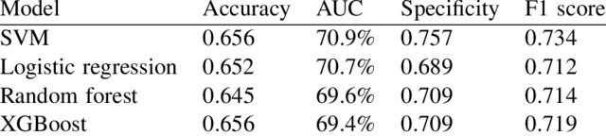
EVALUATION METRICS AND MODEL COMPARISON
EVALUATION METRICS:
ACCURACY: PROPORTION OF CORRECTLY CLASSIFIED INSTANCES.
SPECIFICITY: PROPORTION OF ACTUAL NEGATIVES CORRECTLY IDENTIFIED.
F1 SCORE: HARMONIC MEAN OF PRECISION AND RECALL, SUITABLE FOR IMBALANCED DATA.
EVALUATION FORMULAS:
PRECISION: TP / (TP + FP)
RECALL: TP / (TP + FN)
F1 SCORE: 2 * (RECALL * PRECISION) / (RECALL + PRECISION)
SPECIFICITY: TN / (TN + FP)
MODEL COMPARISON (TABLE 3):
SVM MODEL: SUPERIOR PERFORMANCE ACROSS ALL METRICS.

Slide 16
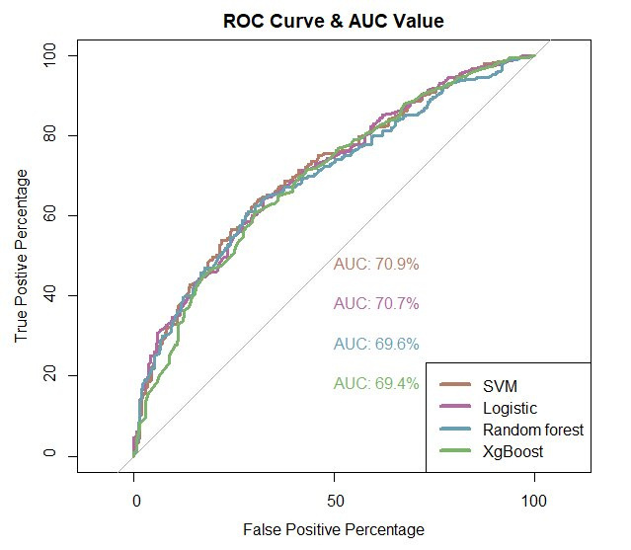
ROC CURVE AND AUC :
SIMILAR ROC CURVES AND AUC VALUES FOR ALL MODELS.
SVM: SELECTED AS THE BEST MODEL DUE TO SUPERIOR PERFORMANCE ACROSS METRICS.

Slide 17
MODEL VALIDATION THROUGH SIMULATED DATA
COUNTY SELECTION:
MIAMI-DADE AND DUVAL COUNTY: TWO LARGEST COUNTIES IN FLORIDA CHOSEN FOR VALIDATION.
SIMULATION PROCESS:
FEATURES:
SIMULATED INCOME, AGE, AND DISASTER EXPERIENCE FOR RESIDENTS.
BERNOULLI DISTRIBUTION: DISASTER EXPERIENCE ASSUMED TO FOLLOW A BERNOULLI DISTRIBUTION WITH P = 0.75.
DATA GENERATION:
MIAMI-DADE COUNTY: 43,000 RESIDENTS SIMULATED, SPLIT INTO 1000 DATA SETS.
DUVAL COUNTY: 18,000 RESIDENTS SIMULATED, ALSO SPLIT INTO 1000 DATA SETS.
PREPAREDNESS PREDICTION FOR MIAMI-DADE AND DUVAL COUNTY

Slide 18
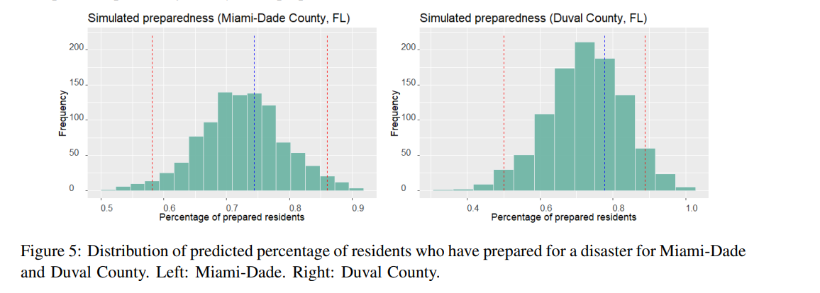
PREDICTION AND VALIDATION:
PREDICTION AND VALIDATION:
PREDICTION: PERCENTAGE OF RESIDENTS PREPARED FOR DISASTERS PREDICTED USING 1000 SIMULATED DATA SETS.
COMPARISON: PREDICTED PERCENTAGES PLOTTED IN HISTOGRAMS.
CONFIDENCE INTERVAL: 95% CONFIDENCE INTERVAL REPRESENTED BY INTERVAL BETWEEN RED DASHED LINES.
RESULT INTERPRETATION:
VALIDATION: PREDICTED PERCENTAGES ENCOMPASS THE ACTUAL PREPAREDNESS PERCENTAGE FROM NHS 2018 DATA.
PREDICTION UNCERTAINTY: DEMONSTRATED THE NECESSITY OF SIMULATIONS FOR RELIABLE DISASTER PREPAREDNESS UNDERSTANDING.

Slide 19
CONCLUSION
RESEARCH INNOVATION:
PROPOSED APPROACH: MACHINE-LEARNING AND SIMULATION-BASED METHOD FOR DISASTER PREPAREDNESS PREDICTION.
DATA SOURCES: UTILIZED FEMA NHS DATA AND LOCAL DEMOGRAPHIC FEATURES FOR ACCURATE PREDICTIONS.
CASE STUDY VALIDATION:
MIAMI-DADE AND DUVAL COUNTY, FL: SUCCESSFUL PREDICTION OF DISASTER PREPAREDNESS ATTITUDES.
ACCURACY AND RELIABILITY: DEMONSTRATED THE MODEL'S ACCURACY AND RELIABILITY IN REAL-WORLD SCENARIOS.
ACADEMIC CONTRIBUTION:
METHODOLOGICAL ADVANCEMENT: DEVELOPED INNOVATIVE FRAMEWORK OVERCOMING SURVEY RESEARCH LIMITATIONS.
ACADEMIC IMPACT: CONTRIBUTES TO DISASTER PREPAREDNESS PREDICTION METHODOLOGIES, FILLING RESEARCH GAPS.
PRACTICAL IMPLICATIONS:
DECISION SUPPORT:
ASSISTS HUMANITARIAN RELIEF ORGANIZATIONS IN ESTIMATING COMMUNITY VULNERABILITY AND PREPAREDNESS.
IMPROVED RESOURCE ALLOCATION: ENABLES BETTER ALLOCATION OF RESOURCES FOR EFFECTIVE DISASTER RESPONSE.
FUTURE RESEARCH:
DATA ENRICHMENT:
INVESTIGATE ADVANCED DATA ENRICHMENT TECHNIQUES FOR HEIGHTENED PREDICTION ACCURACY.
BROADER APPLICATIONS:
EXPLORE DIVERSE DISASTER SCENARIOS AND GEOGRAPHICAL REGIONS FOR COMPREHENSIVE APPLICABILITY.

Slide 20

WE CANNOT STOP NATURAL DISASTERS BUT WE CAN ARM OURSELVES WITH KNOWLEDGE: SO MANY LIVES WOULDN'T HAVE TO BE LOST IF THERE WAS ENOUGH DISASTER PREPAREDNESS.
PETRA NEMCOVA

